Slide 1
Cryptography and Network Security
Third Edition
by William Stallings
Lecture slides by Lawrie Brown

Slide 2
IPSec
general IP Security mechanisms
provides
  authentication
  confidentiality
  key management
applicable to use over LANs, across public & private WANs, & for the Internet

Slide 3
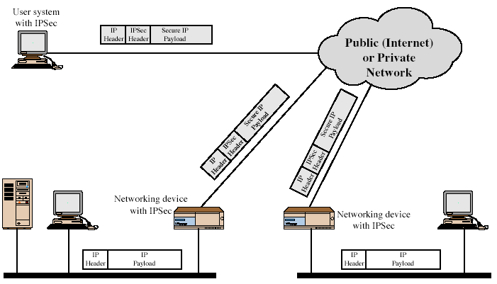
IPSec Uses
Notes:
Stallings Fig 16-1.

Slide 4
Benefits of IPSec
in a firewall/router provides strong security to all traffic crossing the perimeter
is resistant to bypass
is below transport layer, hence transparent to applications
can be transparent to end users
can provide security for individual users if desired

Slide 5
IP Security Architecture
specification is quite complex
defined in numerous RFC’s
  incl. RFC 2401/2402/2406/2408
  many others, grouped by category
mandatory in IPv6, optional in IPv4

Slide 6
IPSec Services
Access control
Connectionless integrity
Data origin authentication
Rejection of replayed packets
  a form of partial sequence integrity
Confidentiality (encryption)
Limited traffic flow confidentiality

Slide 7
Security Associations
a one-way relationship between sender & receiver that affords security for traffic flow
defined by 3 parameters:
  Security Parameters Index (SPI)
  IP Destination Address
  Security Protocol Identifier
has a number of other parameters
  seq no, AH & EH info, lifetime etc
have a database of Security Associations

Slide 8
Authentication Header (AH)
provides support for data integrity & authentication of IP packets
  end system/router can authenticate user/app
  prevents address spoofing attacks by tracking sequence numbers
based on use of a MAC
  HMAC-MD5-96 or HMAC-SHA-1-96
parties must share a secret key

Slide 9
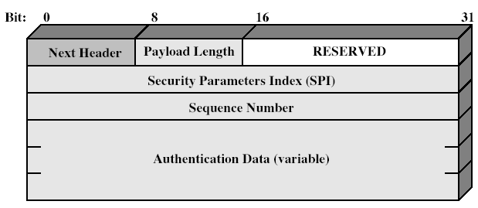
Authentication Header
Notes:
Stallings Fig 16-3.

Slide 10
Encapsulating Security Payload (ESP)
provides message content confidentiality & limited traffic flow confidentiality
can optionally provide the same authentication services as AH
supports range of ciphers, modes, padding
  incl. DES, Triple-DES, RC5, IDEA, CAST etc
  CBC most common
  pad to meet blocksize, for traffic flow

Slide 11
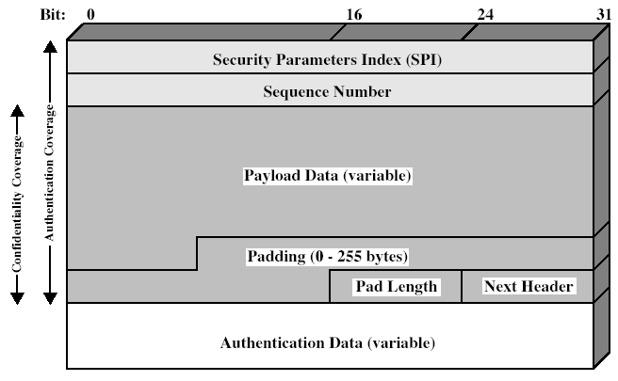
Encapsulating Security Payload
Notes:
Stallings Fig 16-7.

Slide 12
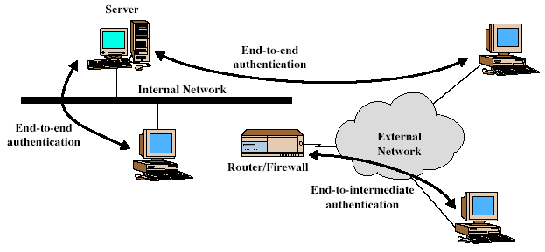
Transport & Tunnel Modes
Notes:
Stallings Fig 16-5.

Slide 13
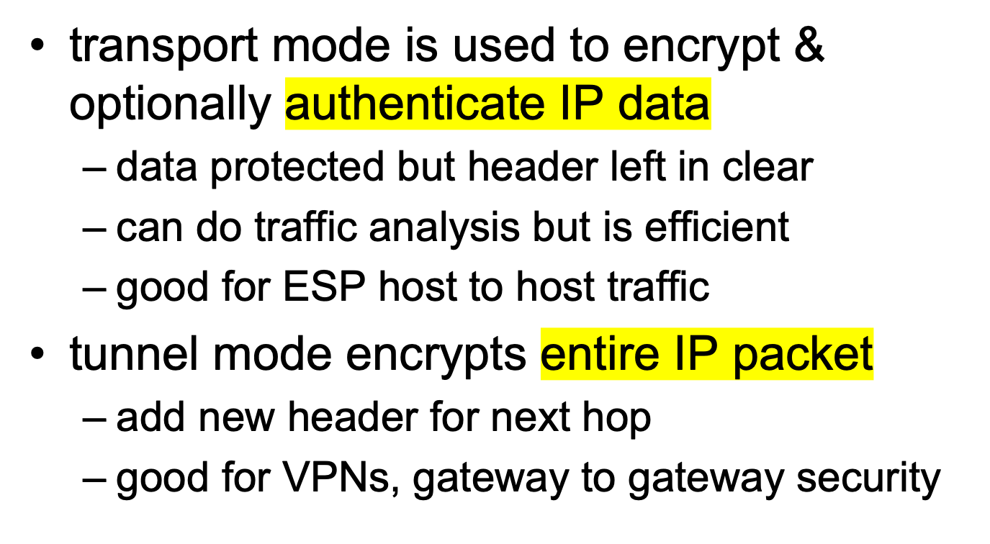
Transport vs Tunnel Mode ESP

Slide 14
Combining Security Associations
SA’s can implement either AH or ESP
to implement both need to combine SA’s
  form a security bundle
have 4 cases (see next)

Slide 15
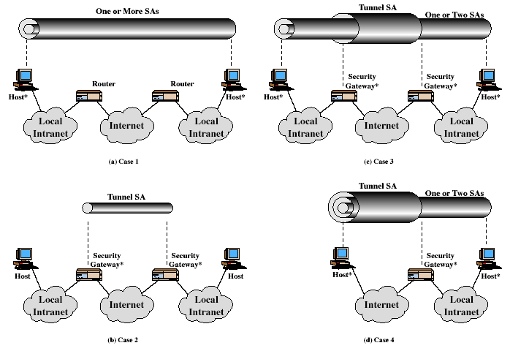
Combining Security Associations
Notes:
Stallings Fig 16-10.

Slide 16
Key Management
handles key generation & distribution
typically need 2 pairs of keys
  2 per direction for AH & ESP
manual key management
  sysadmin manually configures every system
automated key management
  automated system for on demand creation of keys for SA’s in large systems
  has Oakley & ISAKMP elements

Slide 17
Oakley
a key exchange protocol
based on Diffie-Hellman key exchange
adds features to address weaknesses
  cookies, groups (global params), nonces, DH key exchange with authentication
can use arithmetic in prime fields or elliptic curve fields

Slide 18
ISAKMP
Internet Security Association and Key Management Protocol
provides framework for key management
defines procedures and packet formats to establish, negotiate, modify, & delete SAs
independent of key exchange protocol, encryption alg, & authentication method

Slide 19
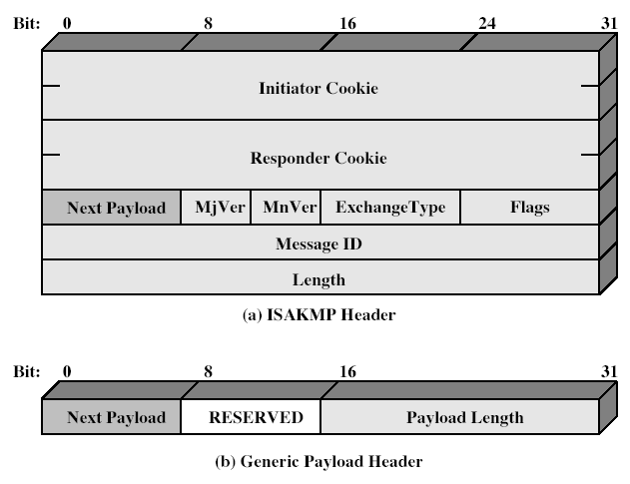
ISAKMP
Notes:
Stallings Fig 16-12.

Slide 20
Summary
have considered:
  IPSec security framework
  AH
  ESP
  key management & Oakley/ISAKMP

